Slide 1
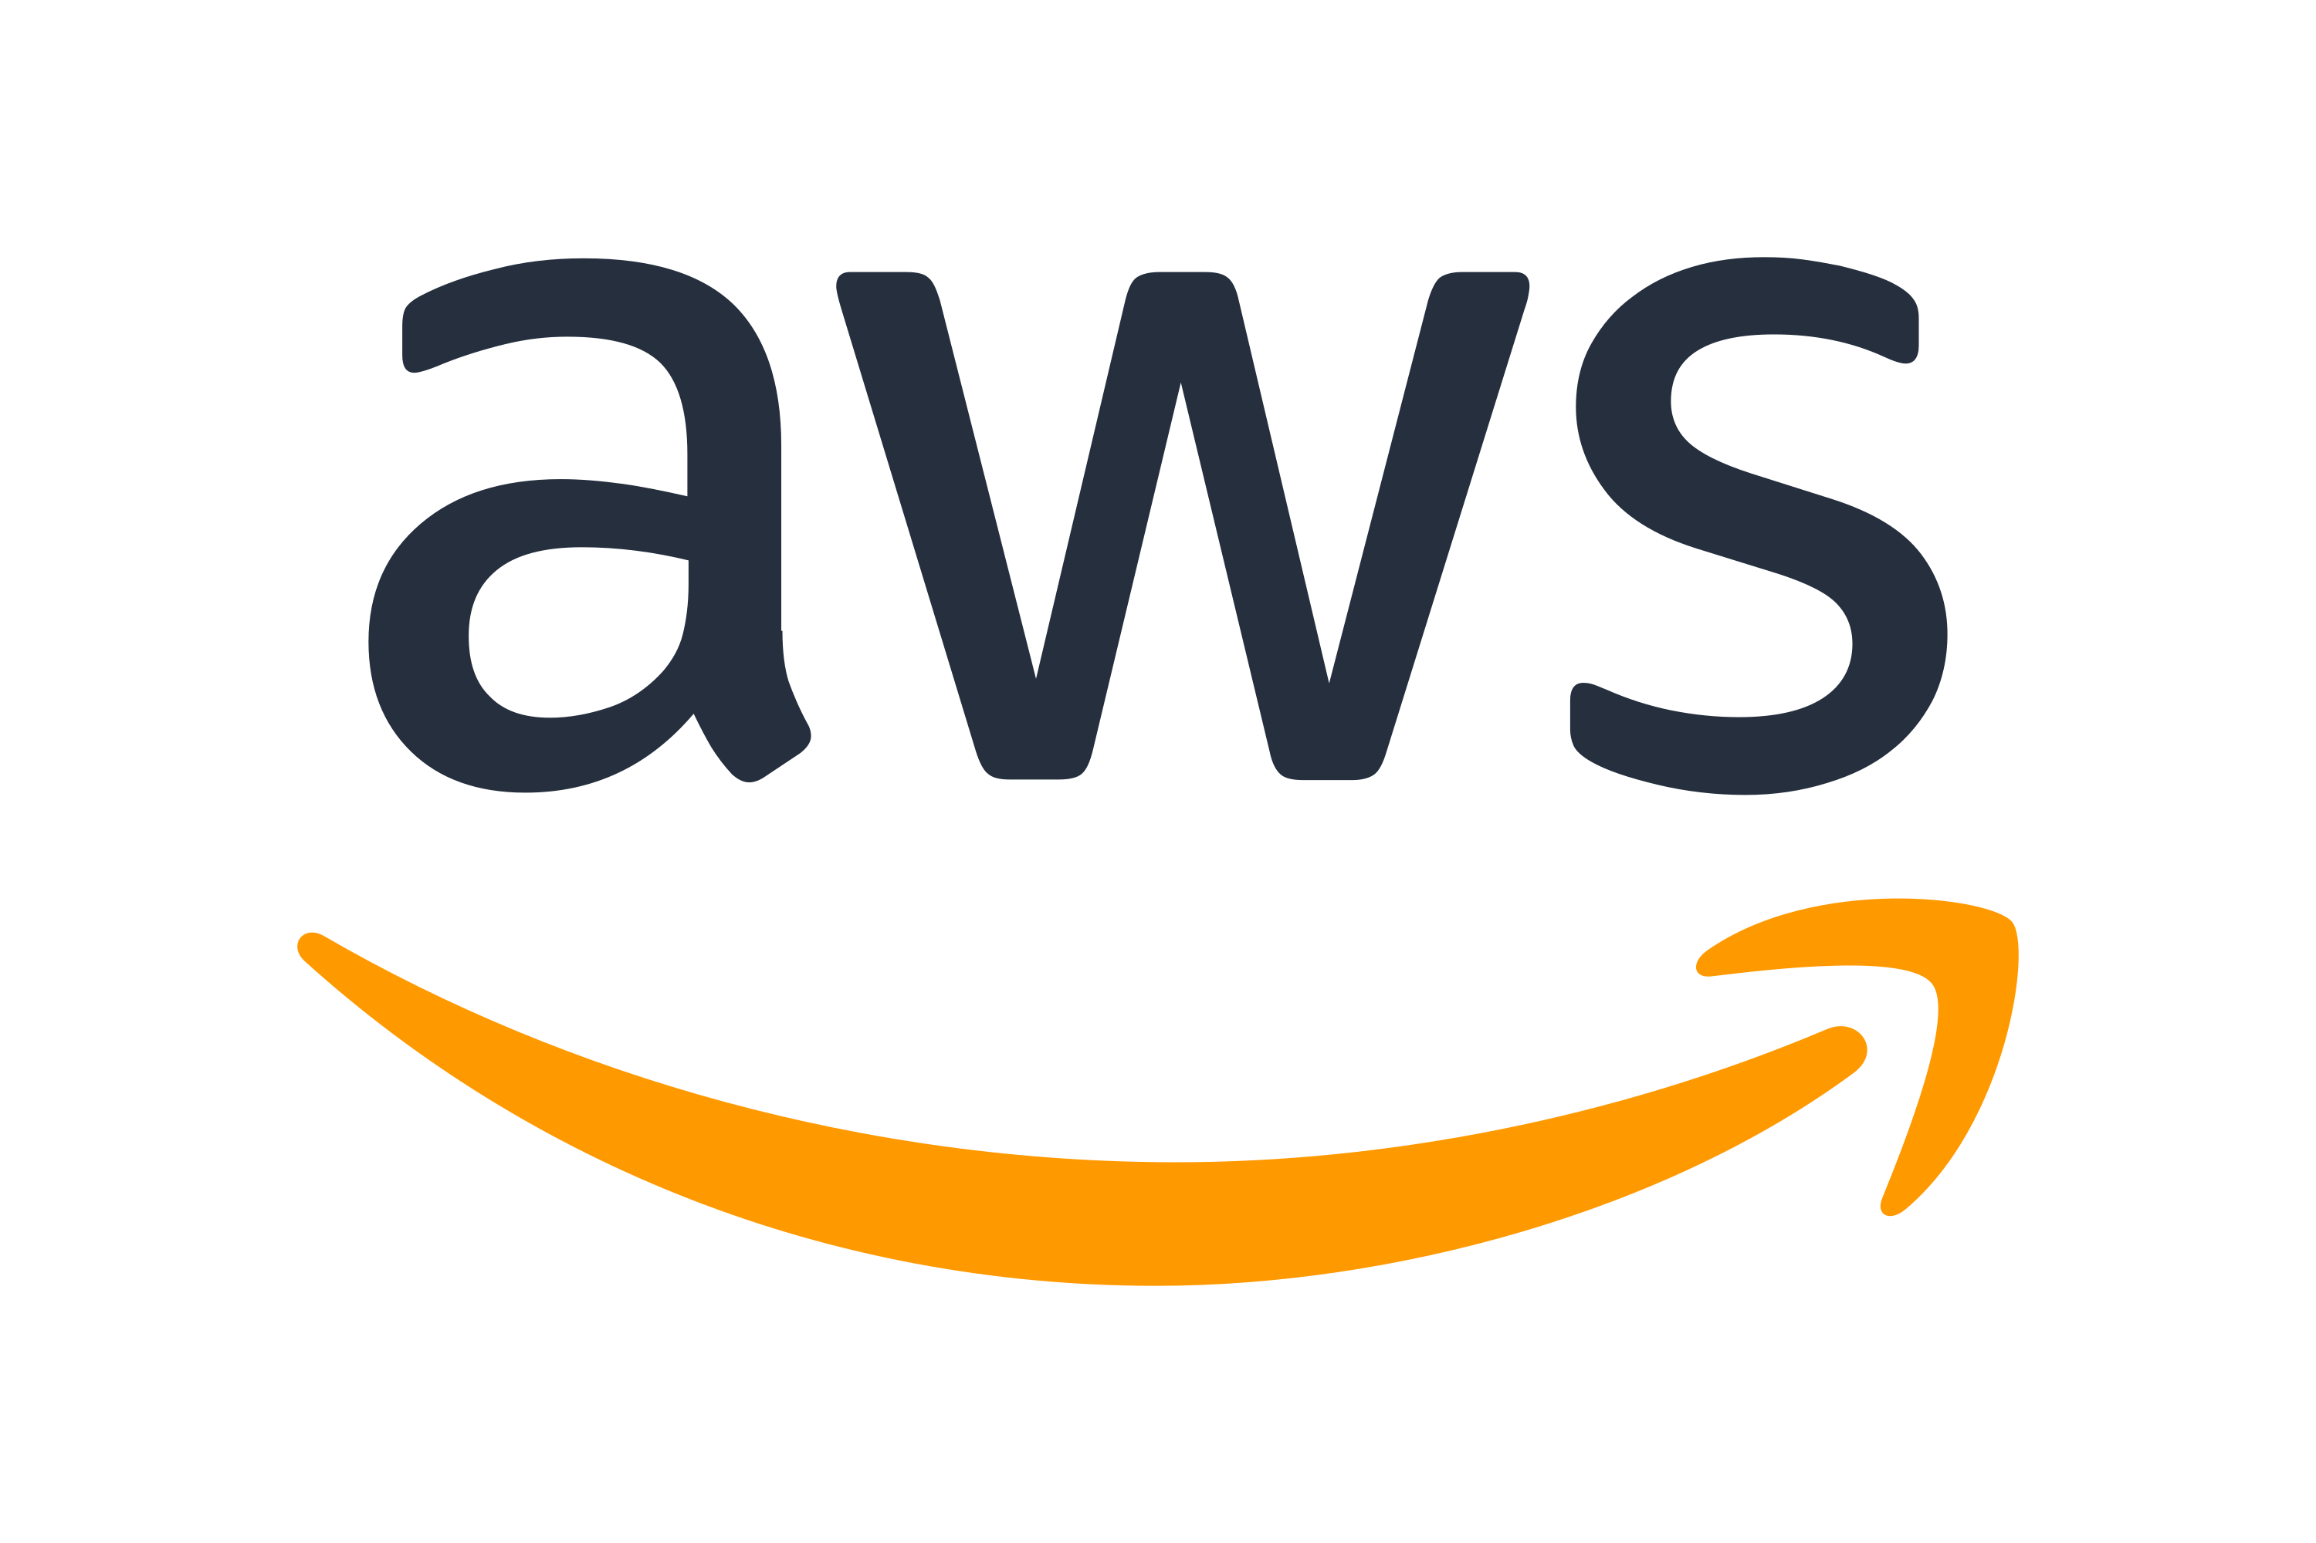
Getting to know Cloud Computing

Slide 2
Let’s Talk About Ourselves

Slide 3
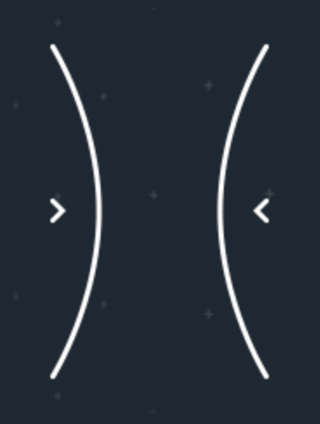
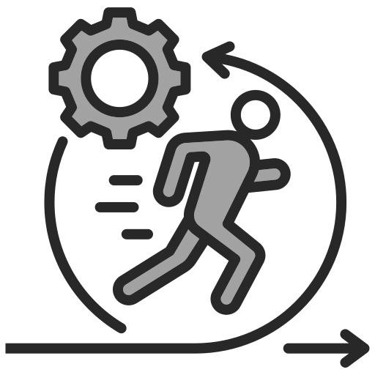
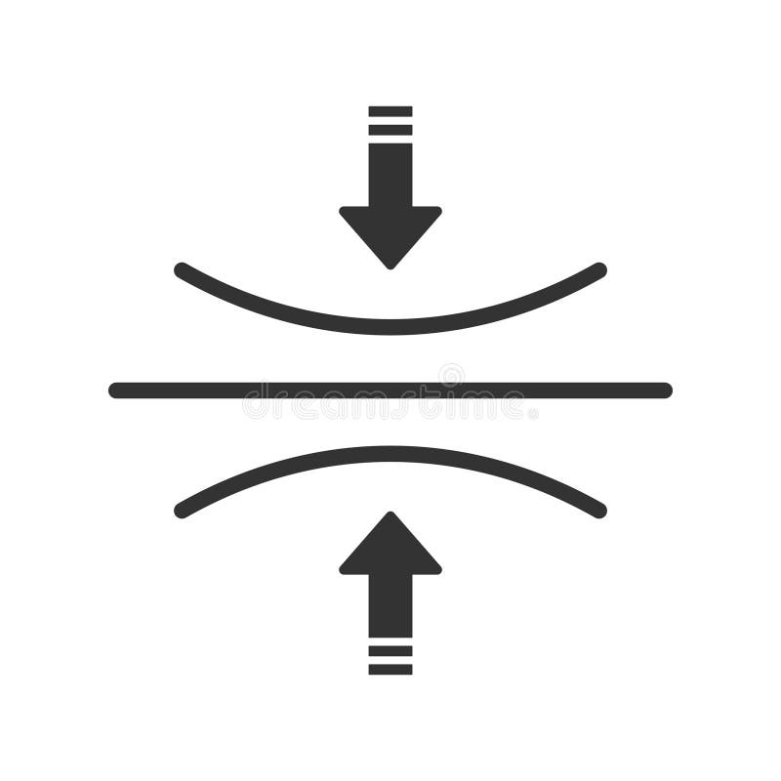
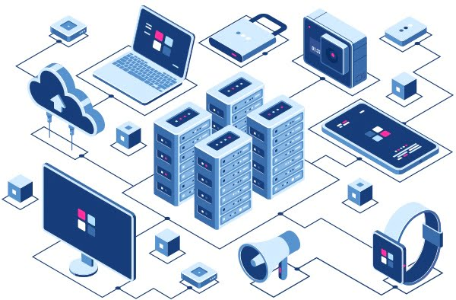
Why Cloud Computing?
Elasticity
Agility
Global Deployment
Cost Saving

Slide 4
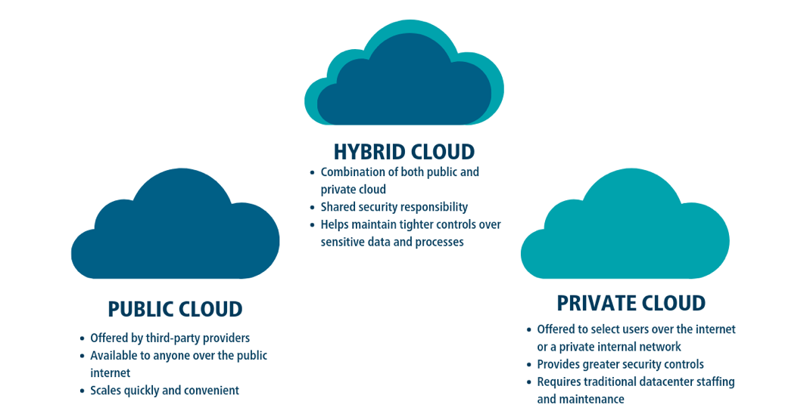
Types of Cloud Systems

Slide 5
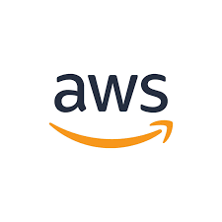
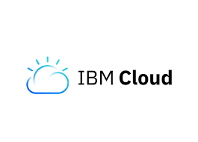
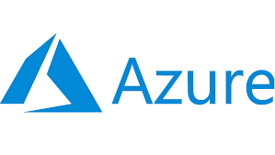
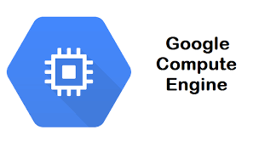
Main Cloud Services
Infrastructure as a service (IaaS)
IaaS contains the basic building blocks for cloud IT and typically provides access to networking features, computers (virtual or on dedicated hardware), and data storage space. IaaS vendors can help you with the highest level of flexibility and management control over your IT resources and is the type most similar to existing IT resources that many IT departments
and developers are familiar with.

Slide 6
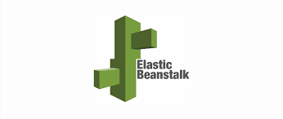
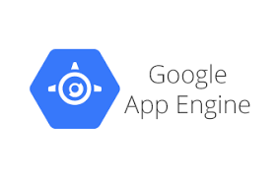
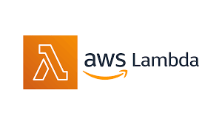
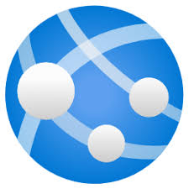
Main Cloud Services
Platform as a service (PaaS)
PaaS vendors remove the need for organizations to manage the underlying infrastructure (usually hardware and operating systems), and this integration allows you to focus on the deployment and management of your applications. This helps you be more efficient, as you don’t need to worry about resource procurement, capacity planning, software maintenance, patching, or any of the other undifferentiated heavy lifting involved in running your application.
Azure App Service

Slide 7
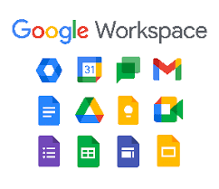
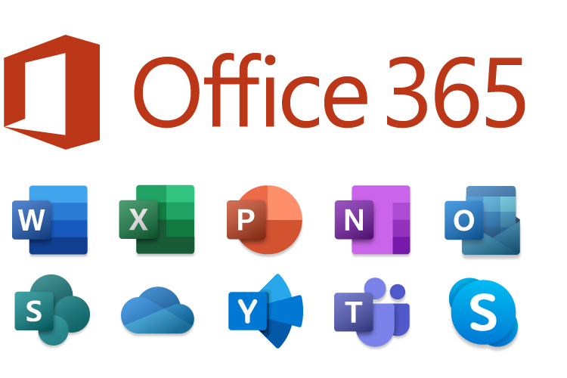
Main Cloud Services
Software as a service (SaaS)
SaaS vendors provide you with software applications that are run and managed by the vendor. In most cases, people referring to SaaS are referring to third-party end-user applications. With a SaaS offering you do not have to worry about how the service is maintained or how the underlying infrastructure is managed;

Slide 8
Infrastructure (as a Service)
Platform (as a Service)
Software (as a Service)
On Premise
Applications
Applications
Applications
Applications
Data
Data
Data
Data
Runtime
Runtime
Runtime
Runtime
Middleware
Middleware
Middleware
Middleware
O/S
O/S
O/S
O/S
Virtualization
Virtualization
Virtualization
Virtualization
Servers
Servers
Servers
Servers
Storage
Storage
Storage
Storage
Networking
Networking
Networking
Networking

Slide 9
IaaS vs. PaaS vs. SaaS
 | Own IT | IaaS | PaaS | SaaS
Data | Y | Y | Y | Y
Application | Y | Y | Y | C
Runtime or software that runs the application | Y | Y | C | C
Middleware or software that monitors the application | Y | Y | C | C
Operating systems on which the application runs | Y | C | C | C
Virtualization technology | Y | C | C | C
Server machines | Y | C | C | C
Storage devices | Y | C | C | C
Network appliances | Y | C | C | C
Y: You manage C: Cloud Service Provider manage

Slide 10
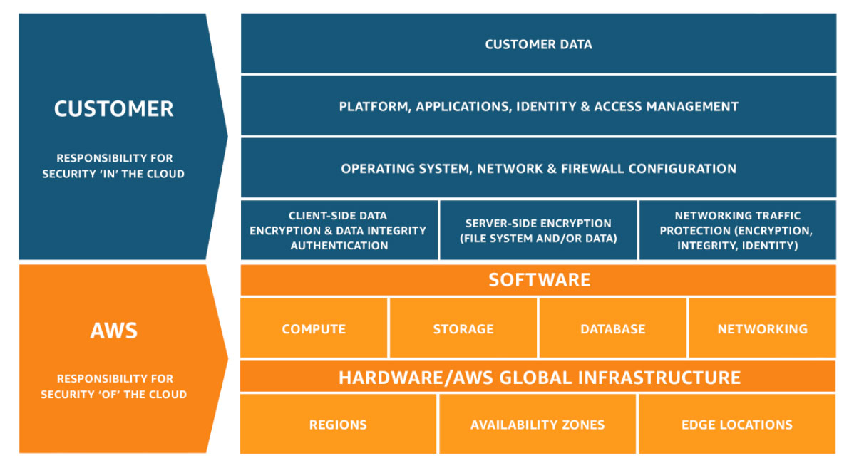
Shared Responsibility Model
Security and Compliance is a shared responsibility between AWS and the customer. This shared model can help relieve the customer’s operational burden as AWS operates, manages and controls the components from the host operating system and virtualization layer down to the physical security of the facilities in which the service operates. Customers should carefully consider the services they choose as their responsibilities vary depending on the services used, the integration of those services into their IT environment, and applicable laws and regulations. The nature of this shared responsibility also provides the flexibility and customer control that permits the deployment.

Slide 11
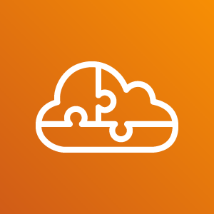
Microservices
Microservices are an architectural and organizational approach to software development where software is composed of small independent services that communicate over well-defined APIs. These services are owned by small, self-contained teams.
Microservices architectures make applications easier to scale and faster to develop, enabling innovation and accelerating time-to-market for new features.

Slide 12
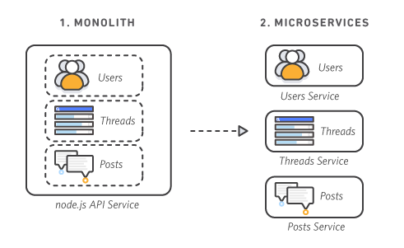
Monolithic vs. Microservices Architecture

Slide 13
Monolithic vs. Microservices Architecture
With monolithic architectures, all processes are tightly coupled and run as a single service.
This means that if one process of the application experiences a spike in demand, the entire architecture must be scaled.
Adding or improving a monolithic application’s features becomes more complex as the code base grows.
This complexity limits experimentation and makes it difficult to implement new ideas.
Monolithic architectures add risk for application availability because many dependent and tightly coupled processes increase the impact of a single process failure.
With a microservices architecture, an application is built as independent components that run each application process as a service.
These services communicate via a well-defined interface using lightweight APIs.
Services are built for business capabilities and each service performs a single function.
Because they are independently run, each service can be updated, deployed, and scaled to meet demand for specific functions of an application.

Slide 14
Characteristics of Microservices
Autonomous
Each component can be developed, deployed, operated, and scaled without affecting the functioning of other services.
Services do not need to share any of their code or implementation with other services.
Any communication between individual components happens via well-defined APIs.
Specialized
Each service is designed for a set of capabilities and focuses on solving a specific problem.
If developers contribute more code to a service over time and the service becomes complex, it can be broken into smaller services.

Slide 15
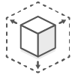
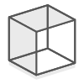
Benefits of Microservices
Agility
Agility
Flexible Scaling
Easy Deployment
Technological Freedom
Reusable Code
Resilience
Flexible Scaling
Reusable Code
Resilience
Technological Freedom
Easy Deployment

Slide 16
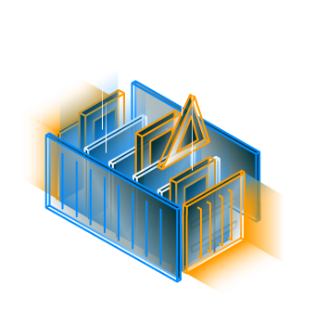
What are Cloud Containers?
Cloud containers are software code packages that contain an application’s code, its libraries, and other dependencies that it needs to run in the cloud.
Traditionally, software had to be packaged in multiple formats to run in different environments such as Windows, Linux, Mac, and mobile. However, a container packages the software and all of its dependencies into a single file that can run anywhere.

Slide 17
Benefits
Use Cases
Simplified application deployment
Flexibility
Resiliency
Scalability
Microservices
DevOps
Hybrid cloud

Slide 18
How do cloud containers work?
A cloud container is simply a container that runs on cloud infrastructure rather than on a local machine or in a data center.
Containers in cloud computing are image files that contain everything needed to run software: code, runtime, libraries, environment variables, and configuration files.
The images are constructed in layers, starting from a base image and then adding additional layers as specified by instructions in a container configuration file.
Once the container images is created, they don’t change. You can store images in a container registry and reuse them consistently across different cloud environments.

Slide 19
Summary

Slide 20
Why Cloud Computing?
Agility
Elasticity
Cost savings
Deploy globally in minutes

Slide 21
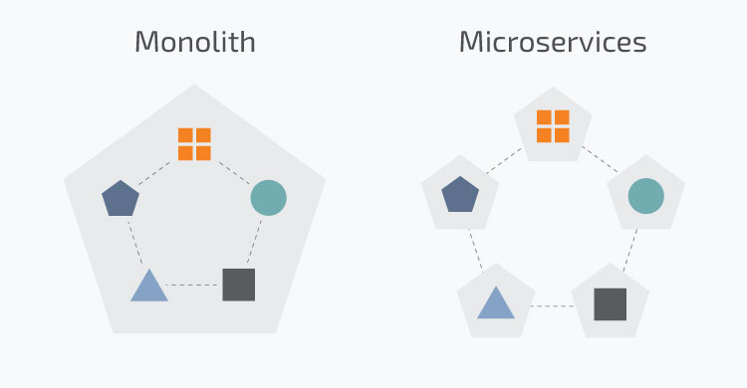
Monolithic vs. Microservices Architecture

Slide 22
Benefits of Microservices
Flexible Scaling
Easy Deployment
Technological Freedom
Reusable Code
Resilience
Agility

Slide 23
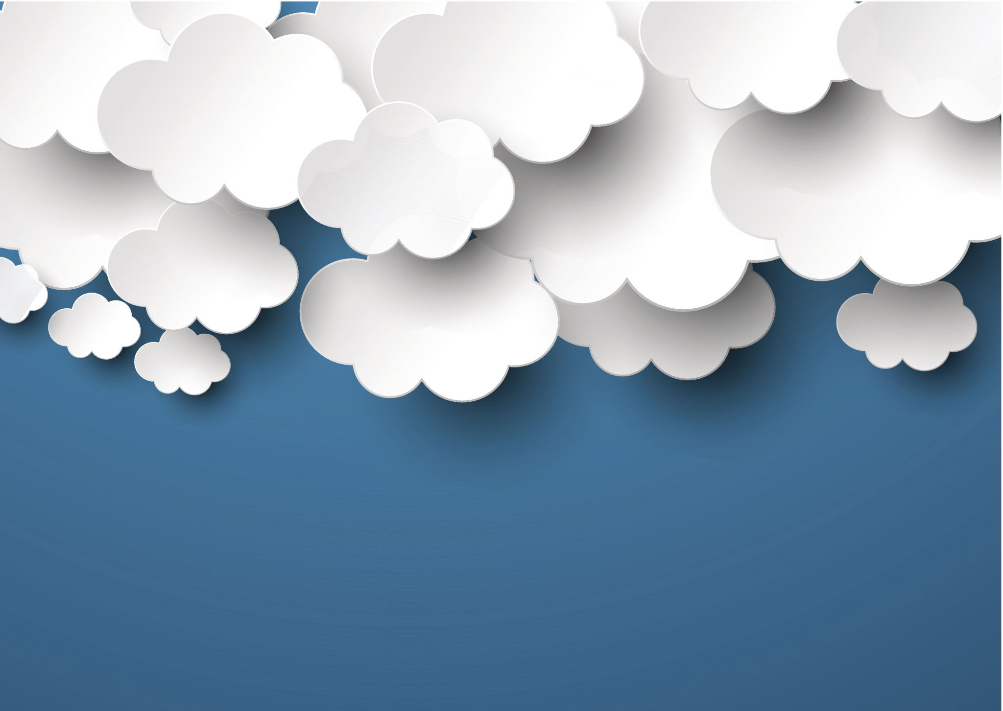
What is Cloud Native?
Cloud native is the software approach of building, deploying, and managing modern applications in cloud computing environments. Modern companies want to build highly scalable, flexible, and resilient applications that they can update quickly to meet customer demands. To do so, they use modern tools and techniques that inherently support application development on cloud infrastructure. These cloud-native technologies support fast and frequent changes to applications without impacting service delivery, providing adopters with an innovative, competitive advantage.

Slide 24
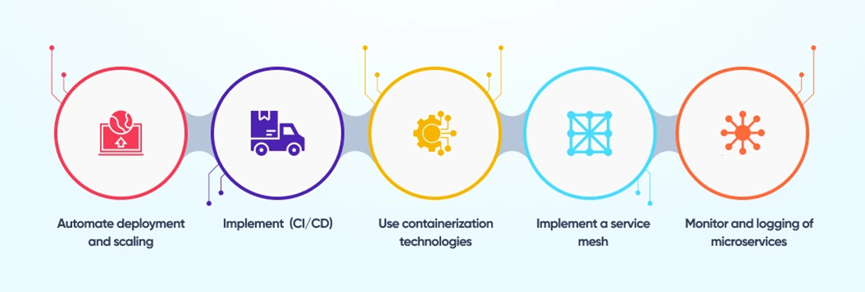
Cloud Native Architecture Principles

